Slide 1


Gustavo Roncador Borges
October 2023

Slide 2

Outline
Executive Summary
Introduction
Methodology
Results
Conclusion
Appendix

Slide 3

Executive Summary
Methodologies:
Web scraping for data collection
Data wrangling and cleaning
SQL analysis for insights
Data exploration and visualization
Feature engineering
Machine learning for prediction
Results:
83.33% accuracy for predicting Falcon9 first-stage landing outcomes
Analyzed launch site locations and success factors
Developed a user-friendly dashboard for visual analytics
Identified key insights into SpaceX's operations and their impact on space missions

Slide 4
Introduction
Project Background and Context:
SpaceX's pioneering role in the space industry
Significance of Falcon 9 rocket and its reusable first stage
The need for cost-effective space launches
Problems to Find Answers:
Predicting the success of Falcon 9 first-stage landings
Help estimating the cost of launches
Understanding the factors influencing successful space missions
Providing insights for potential competitors in the space launch market

Slide 5

Section 1

Slide 6
Methodology
Executive Summary
Data collection methodology:
Utilized SpaceX API and web scraping to collect Falcon 9 launch records from Wikipedia
Extracted and converted data into Pandas data frames
Perform data wrangling
Conducted data cleaning and transformation
Prepared data for analysis by standardizing and structuring it
Perform exploratory data analysis (EDA) using visualization and SQL
Perform interactive visual analytics using Folium and Plotly Dash
Perform predictive analysis using classification models
Developed Linear Regression, Support Vector Machine, Decision Trees, and K-Nearest Neighbor machine learning models for predictions

Slide 7
Data Collection
Data sources:
SpaceX REST API calls
Web scraping Wikipedia's 'List of Falcon 9 and Falcon Heavy launches’ using BeautifulSoup
Extracted information about Falcon 9 launches
Conversion of raw data into structured Pandas data frames
Initial data sets obtained for further analysis
Start
Initiating the data collection process.
Web Scraping
Incorporating additional data using BeautifulSoup to extract data from Wikipedia.
Data Transformation
Converting raw data into structured Pandas data frames.
Data Cleaning
Cleaning and preprocessing data for analysis.
End
Concluding the data collection phase.
SpaceX API
Accessing Launch information from SpaceX Database.

Slide 8
Data Collection – SpaceX API
Objective: Predict Falcon 9 first stage landings
Collecting data from SpaceX API
API provides launch information
Filter for Falcon 9 launches
Data Wrangling
Handling missing values
Replacing NaN in PayloadMass
Preparing the dataset
Pre-selected date range
Data exported to CSV for next steps
Request SpaceX API Data
Retrieve data from the SpaceX API using the requests.get() method.
Data Filtering
API Call for Details
Data Collection from API
Combine Data
Data Cleaning
Export Data
Select Falcon 9 launches and specific columns from the dataset.
Fetch detailed information for each launch.
Collect various data elements such as payload mass, outcome, and more.
Create a structured dataset by merging the collected data from the API.
Handle missing values and preprocess the data for analysis.
Save the cleaned dataset to a CSV file for further use.
External reference: GitHub Repository of Jupyter Notebook for SpaceX Data Collection via API.

Slide 9
Data Collection - Scraping
Python libraries used: requests, BeautifulSoup
Handling and parsing table elements
Addressing noisy data and annotations
Creating a Pandas data frame
Collecting Falcon 9 launch records from Wikipedia
Source: 'List of Falcon 9 and Falcon Heavy launches'
Snapshot: Last updated on June 9, 2021
Using the requests.get() method to request the Falcon 9 Launch HTML page.
Create BeautifulSoup
Creating a BeautifulSoup object from the HTML response content.
Extract Column Names
Finding all tables on the Wiki page and extracting relevant column names.
Iterate Tables
Identifying the target table containing launch records.
Extract Launch Records
Parsing table rows to extract launch records.
Data Transformation
Converting raw data into a structured Pandas data frame.
Data Cleaning
Cleaning and preprocessing data for analysis.
Request HTML Page
External reference: GitHub Repository of Jupyter Notebook for SpaceX Data Collection via Web Scraping.

Slide 10
Data Wrangling
Objective: Prepare Falcon 9 dataset for analysis.
Identified and and handled missing values.
Determined numerical and categorical columns.
Created labels for successful and unsuccessful landings.
Load Data
Identify Missing Values
Identify Data Types
Calculate Launch Sites
Calculate Orbits
Calculate Mission Outcomes
Create Landing Outcome Label
Load the Space X dataset from the given URL.
Calculate the percentage of missing values in each attribute.
Determine which columns are numerical and categorical.
Calculate the number of launches on each site.
Calculate the number and occurrence of each orbit.
Calculate the number and occurrence of mission outcomes per orbit type.
Create a landing outcome label from the "Outcome" column.
External reference: GitHub Repository of Jupyter Notebook for SpaceX Data Wrangling

Slide 11
EDA with Data Visualization
Success Rates by Launch Site & Flight Number: Different sites have varying success rates.
Success Rates by Launch Site & Payload: Showed no rockets launched for payload greater than 10,000 Kg at the VAFB-SLC launch site.
Success Rates by Orbit: Displayed the success rate of different orbit types (e.g., SSO, GEO, and ES-L1 have higher success rates).
Success Rates by Orbit & Flight Number: Explored the relationship between Flight Number and Success for each Orbit type (number of flights appears related to success for LEO orbit).
Success Rates by Orbit & Payload: Revealed that heavy payloads have higher success rates in Polar, LEO, and ISS orbits.
Yearly Success Trend: Plotted the average launch success trend, showing an increasing success rate from 2013 to 2020.
External reference: GitHub Repository of Jupyter Notebook for EDA with Data Visualization

Slide 12
EDA with SQL
These queries were executed to analyze SpaceX data within a Db2 database
Unique Launch Sites: Display unique launch site names.
Launch Sites Starting with 'CCA': Show 5 records of launch sites that start with 'CCA'.
Total Payload Mass by NASA (CRS): Find the total payload mass carried by boosters launched by NASA (CRS).
Average Payload Mass of F9 v1.1: Calculate the average payload mass carried by booster version F9 v1.1.
First Successful Ground Pad Landing Date: List the date of the first successful landing outcome on a ground pad.
Successful Drone Ship Landings with Payload Constraints: Identify booster names with successful drone ship landings and payload mass between 4000 and 6000.
Mission Outcomes Count: Count the total number of successful and failure mission outcomes.
Max Payload Carriers: Find booster versions that carried the maximum payload mass.
Failure Landings in 2015: List records displaying month names, failure landing outcomes on drone ships, booster versions, and launch sites for the year 2015.
Landing Outcomes Ranking: Rank the count of landing outcomes between June 4, 2010, and March 20, 2017, in descending order.
External reference: GitHub Repository of Jupyter Notebook for EDA with SQL

Slide 13
Build an Interactive Map with Folium
Objective: Conducted an in-depth analysis of SpaceX launch site locations using Folium, a powerful interactive mapping library in Python.
Main Map Objects Created:
Markers: To precisely locate and identify each launch site on the map.
Circles: To provide a visual representation of the launch site areas for better understanding.
Marker Clusters: To group and categorize launch outcomes for quick assessment.
External reference: GitHub Repository of Jupyter Notebook for Interactive Map with Folium

Slide 14
Build a Dashboard with Plotly Dash
Objective:
To provide a user-friendly interface for real-time analysis of SpaceX launch data.
To enable stakeholders to make informed decisions based on visualized insights.
To enhance understanding of the factors affecting launch success, including payload mass and launch site selection.
Plots/Graphs:
Pie Chart: Visualizes the distribution of launch success for selected sites. Helps identify the most successful launch site.
Scatter Chart: Correlates payload mass with launch success and booster versions. Offers insights into mission outcomes.
Interactions:
Launch Site Dropdown: Allows users to select specific launch sites or view data for all sites.
Payload Range Slider: Permits the selection of payload mass ranges for analysis.
Add the GitHub URL of your completed Plotly Dash lab, as an external reference and peer-review purpose
External reference: GitHub Repository of Jupyter Notebook for Interactive Dashboard

Slide 15
Predictive Analysis (Classification)
Built, Evaluated, Improved, and Determined Best Performing Model
Conducted Exploratory Data Analysis
Engineered Training Labels
Standardized Data
Split Data (Train-Test Split)
Data Preparation
Loaded and Preprocessed Data
Standardized Features
Model Selection
Utilized Multiple Classification Algorithms
Hyperparameter Tuning
Employed GridSearchCV for Optimal Parameters
Model Evaluation
Assessed Model Accuracy on Validation Data
Visualized Confusion Matrices
Performance Comparison
Determined Best Performing Model
External reference: GitHub Repository of Python Code for Predictive Analysis

Slide 16
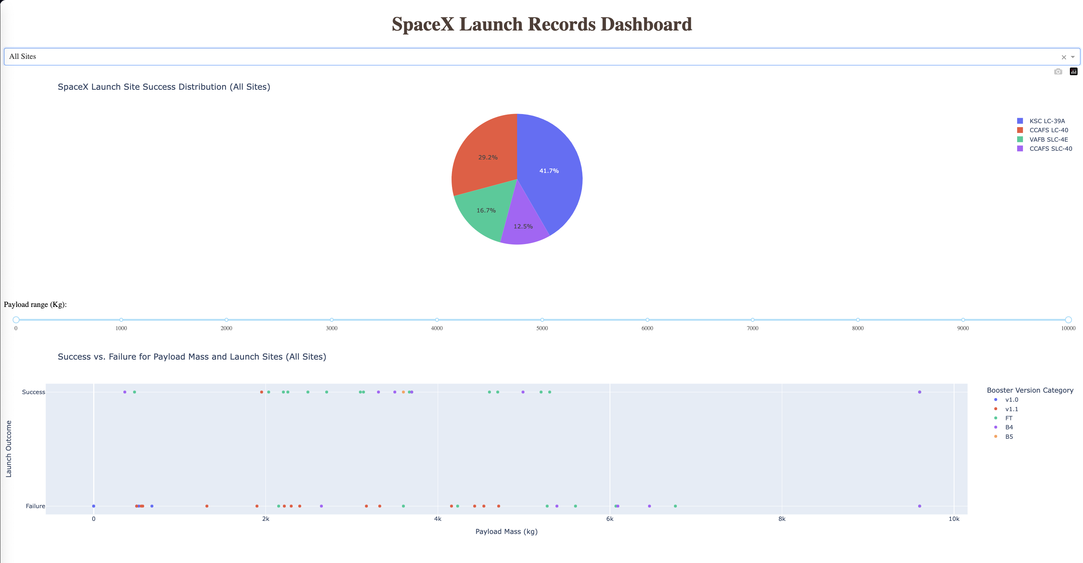
Results
Exploratory data analysis results
CCAFS SLC-40 has the highest success rate at 60%.
KSC LC-39A and VAFB SLC-4E have success rates of 77%.
The most frequent orbit types are GTO, ISS, and VLEO.
Success rates vary by orbit type.
SSE, HEO, GEO, and ES-L1 orbits have a 100% success rate.
Other orbit types show varying success rates.
Predictive analysis results
Multiple machine learning models, including Logistic Regression, SVM, Decision Tree, and KNN, performed equally well, achieving an accuracy of 83.33%.
Interactive analytics demo

Slide 17

Section 2

Slide 18
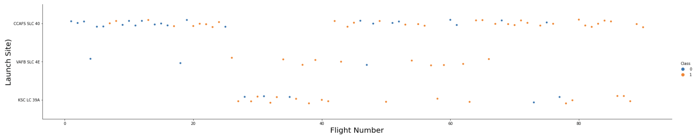
Flight Number vs. Launch Site
This scatter plot illustrates the relationship between the flight number (x-axis) and the launch site (y-axis).
Findings:
CCAFS LC-40: No strong relationship between flight number and success rate. Success appears consistent across various flight numbers.
KSC LC-39A: Similarly, no strong correlation between flight number and success rate. Success rates vary across flight numbers.
VAFB SLC 4E: Success rates appear consistent, regardless of flight number.

Slide 19
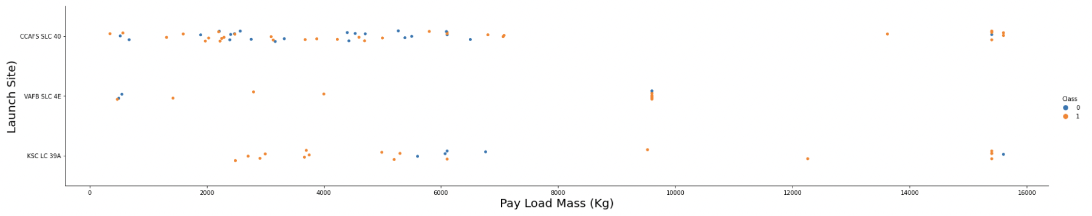
Payload vs. Launch Site
This scatter plot illustrates the relationship between payload mass (x-axis) and launch site (y-axis).
Findings:
VAFB-SLC: No rockets launched for heavy payload mass (greater than 10,000).
Other Launch Sites: Rockets launched for a range of payload masses.
The launch site affects payload capacity and handling.

Slide 20
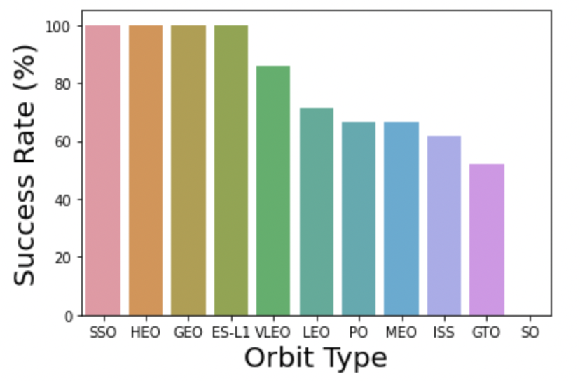
Success Rate vs. Orbit Type
This bar chart compares success rates for different orbit types.
Findings:
SSE, HEO, GEO, ES-L1 Orbits: 100% success rates, indicating high reliability.
Other Orbit Types: Varying success rates, suggesting mission complexities.

Slide 21
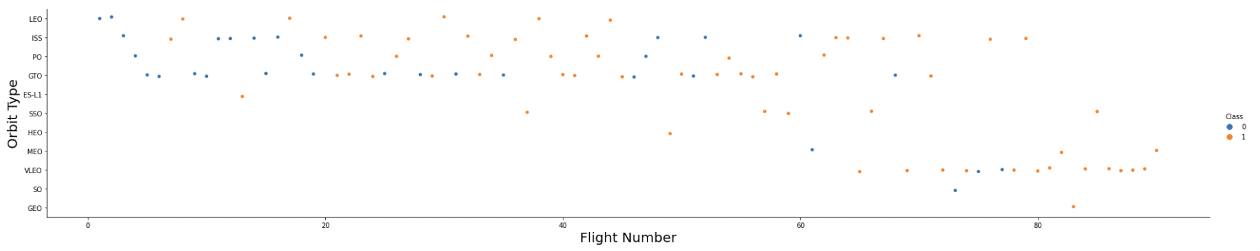
Flight Number vs. Orbit Type
This scatter plot shows the relationship between flight number (x-axis) and orbit type (y-axis).
Findings:
LEO Orbit: Success appears correlated with the number of flights.
GTO Orbit: No clear relationship between flight number and success.

Slide 22
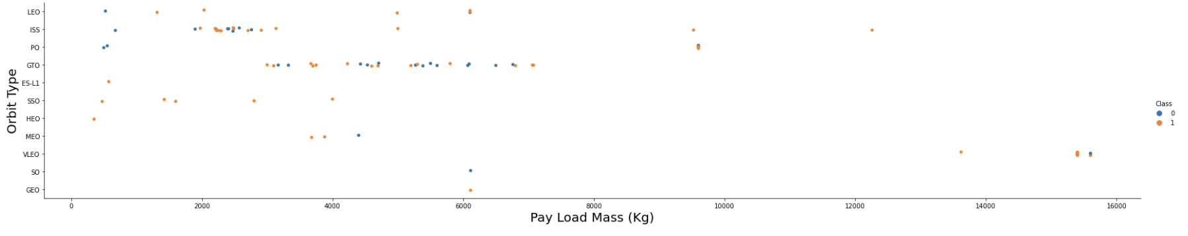
Payload vs. Orbit Type
This scatter plot illustrates the relationship between payload mass (x-axis) and orbit type (y-axis).
Findings:
PO, LEO, ISS Orbits: Higher payload mass corresponds to a more successful landing.
GTO Orbit: Payload mass does not clearly affect landing success.

Slide 23
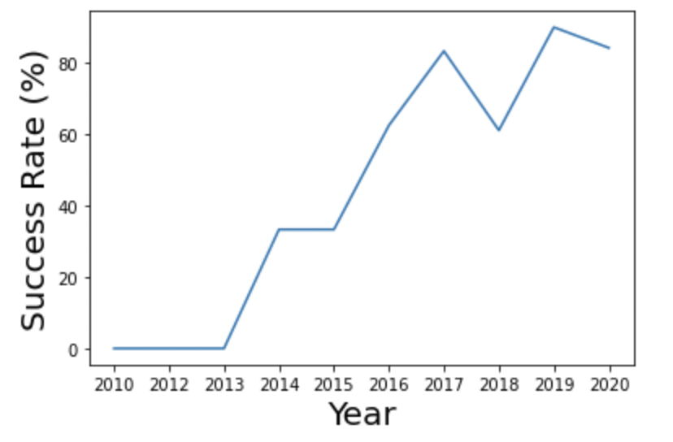
Launch Success Yearly Trend
This line chart displays the trend in launch success rates over the years.
Findings:
2013 to 2020: Consistent increase in success rates.
Highlight: SpaceX's continual improvement in launch reliability.

Slide 24
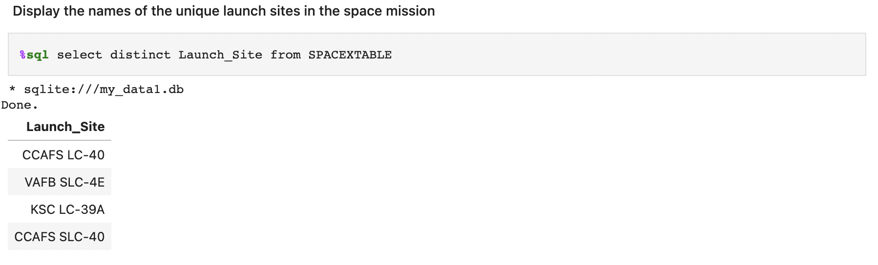
All Launch Site Names
Query: Selects and displays the distinct (unique) launch site names from the SPACEXTABLE.
Purpose: To identify the different launch sites used in the space missions.

Slide 25
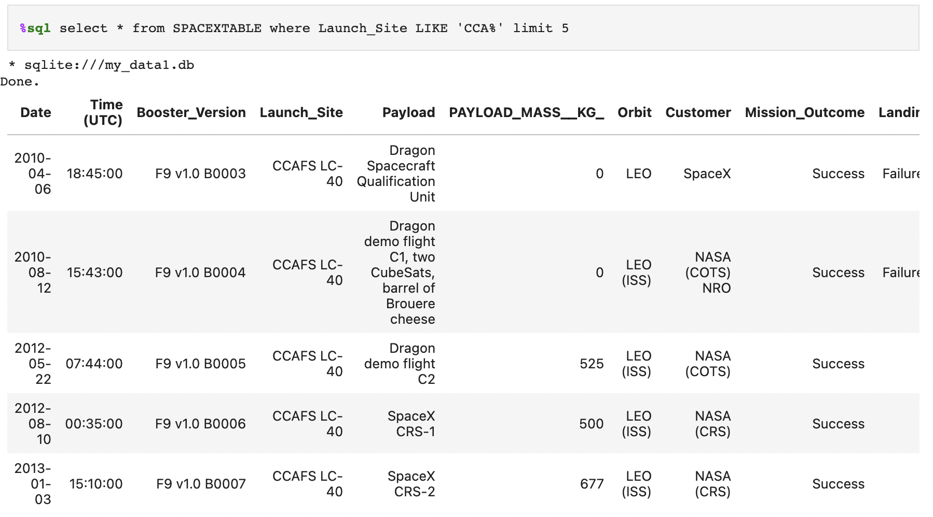
Launch Site Names Begin with 'CCA'
Query: Selects and displays records from the SPACEXTABLE where the launch site names start with 'CCA,' limiting the results to the first 5 records.
Purpose: To find launch site records that match a specific pattern.

Slide 26
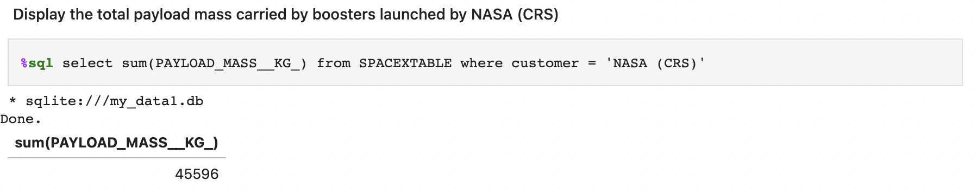
Total Payload Mass
Query: Calculates the total payload mass of boosters launched by NASA (CRS) and displays the result.
Purpose: To determine the combined payload mass of missions conducted for NASA's Commercial Resupply Services (CRS).

Slide 27
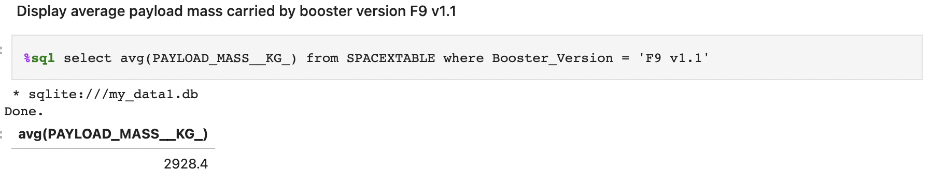
Average Payload Mass by F9 v1.1
Query: Calculates and displays the average payload mass carried by boosters with the version 'F9 v1.1.'
Purpose: To find the average payload mass for a specific booster version.

Slide 28
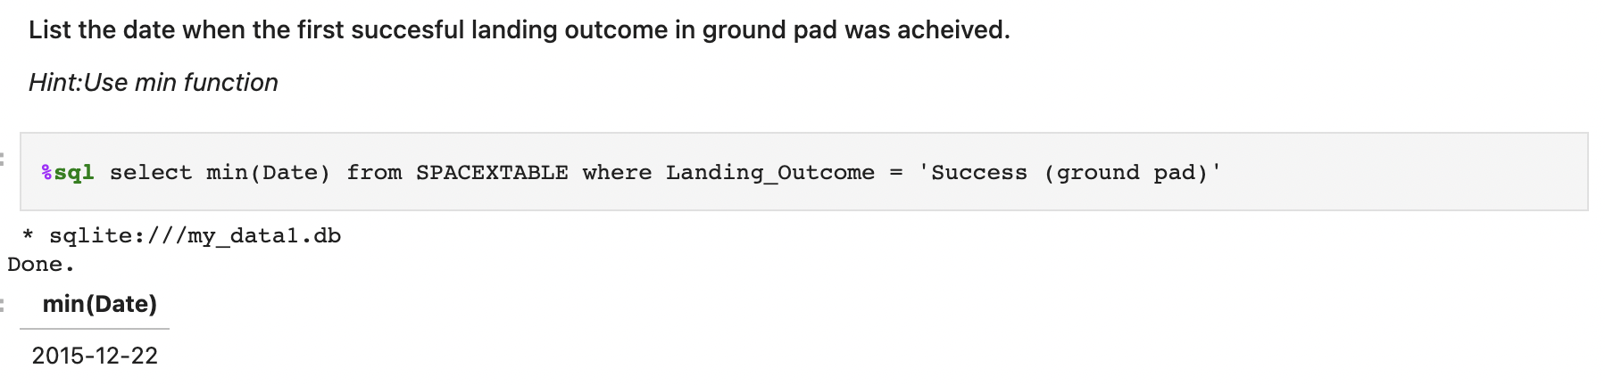
First Successful Ground Landing Date
Query: Identifies the minimum (earliest) date when a successful ground pad landing outcome was achieved.
Purpose: To determine the date of the first successful ground pad landing.

Slide 29
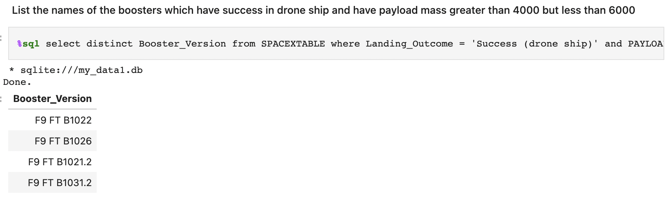
Successful Drone Ship Landing with Payload between 4000 and 6000
%sql select distinct Booster_Version from SPACEXTABLE where Landing_Outcome = 'Success (drone ship)' and PAYLOAD_MASS__KG_ > 4000 and PAYLOAD_MASS__KG_ < 6000
Query: Lists the distinct booster versions that have achieved a successful landing on a drone ship while carrying a payload mass greater than 4000 and less than 6000.
Purpose: To find booster versions that meet specific landing and payload criteria.

Slide 30
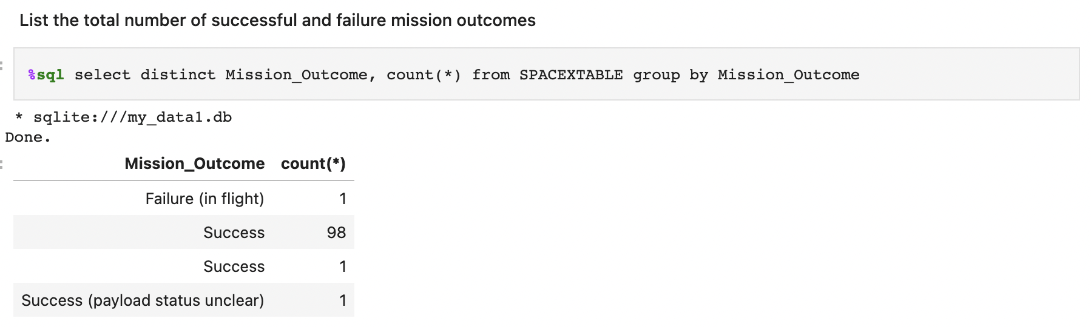
Total Number of Successful and Failure Mission Outcomes
Query: Counts the number of occurrences for each distinct mission outcome and displays the results.
Purpose: To analyze the distribution of mission outcomes.

Slide 31
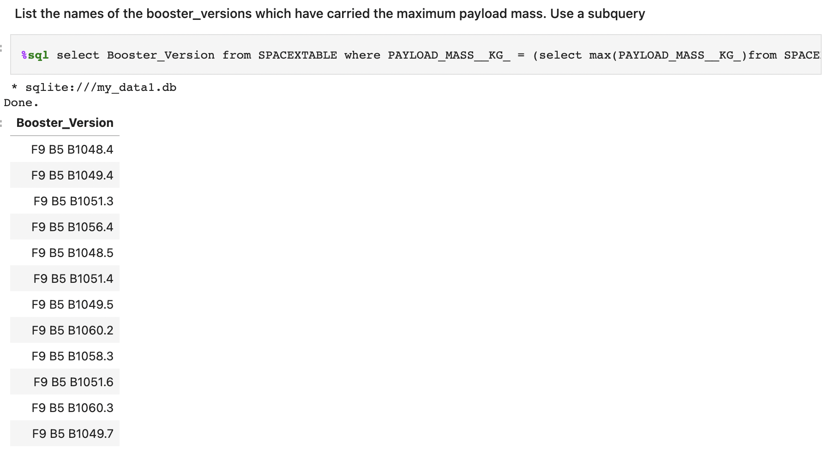
Boosters Carried Maximum Payload
%sql select Booster_Version from SPACEXTABLE where PAYLOAD_MASS__KG_ = (select max(PAYLOAD_MASS__KG_)from SPACEXTABLE)
Query: Identifies the booster version(s) that carried the maximum payload mass.
Purpose: To find the booster version(s) with the highest payload capacity.

Slide 32

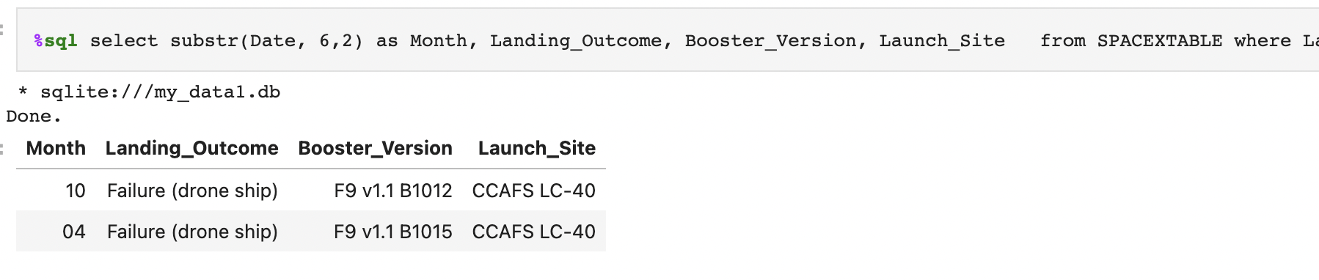
2015 Launch Records
%sql select substr(Date, 6,2) as Month, Landing_Outcome, Booster_Version, Launch_Site from SPACEXTABLE where Landing_Outcome = 'Failure (drone ship)' and substr(Date,0,5) = '2015'
Query: Selects records that display the month, landing outcome, booster version, and launch site for missions with a failure landing outcome on a drone ship in the year 2015.
Purpose: To retrieve details about missions with specific outcomes during a particular year.

Slide 33
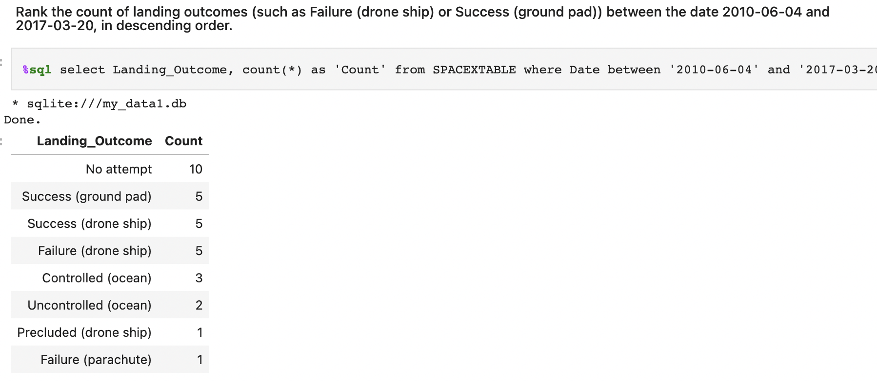
Rank Landing Outcomes Between 2010-06-04 and 2017-03-20
%sql select Landing_Outcome, count(*) as 'Count' from SPACEXTABLE where Date between '2010-06-04' and '2017-03-20' group by Landing_Outcome order by Count desc
Query: Ranks and displays the count of landing outcomes (e.g., success on a drone ship) between specific date ranges in descending order.
Purpose: To rank and analyze the frequency of landing outcomes within a specified time frame.

Slide 34

Section 3

Slide 35
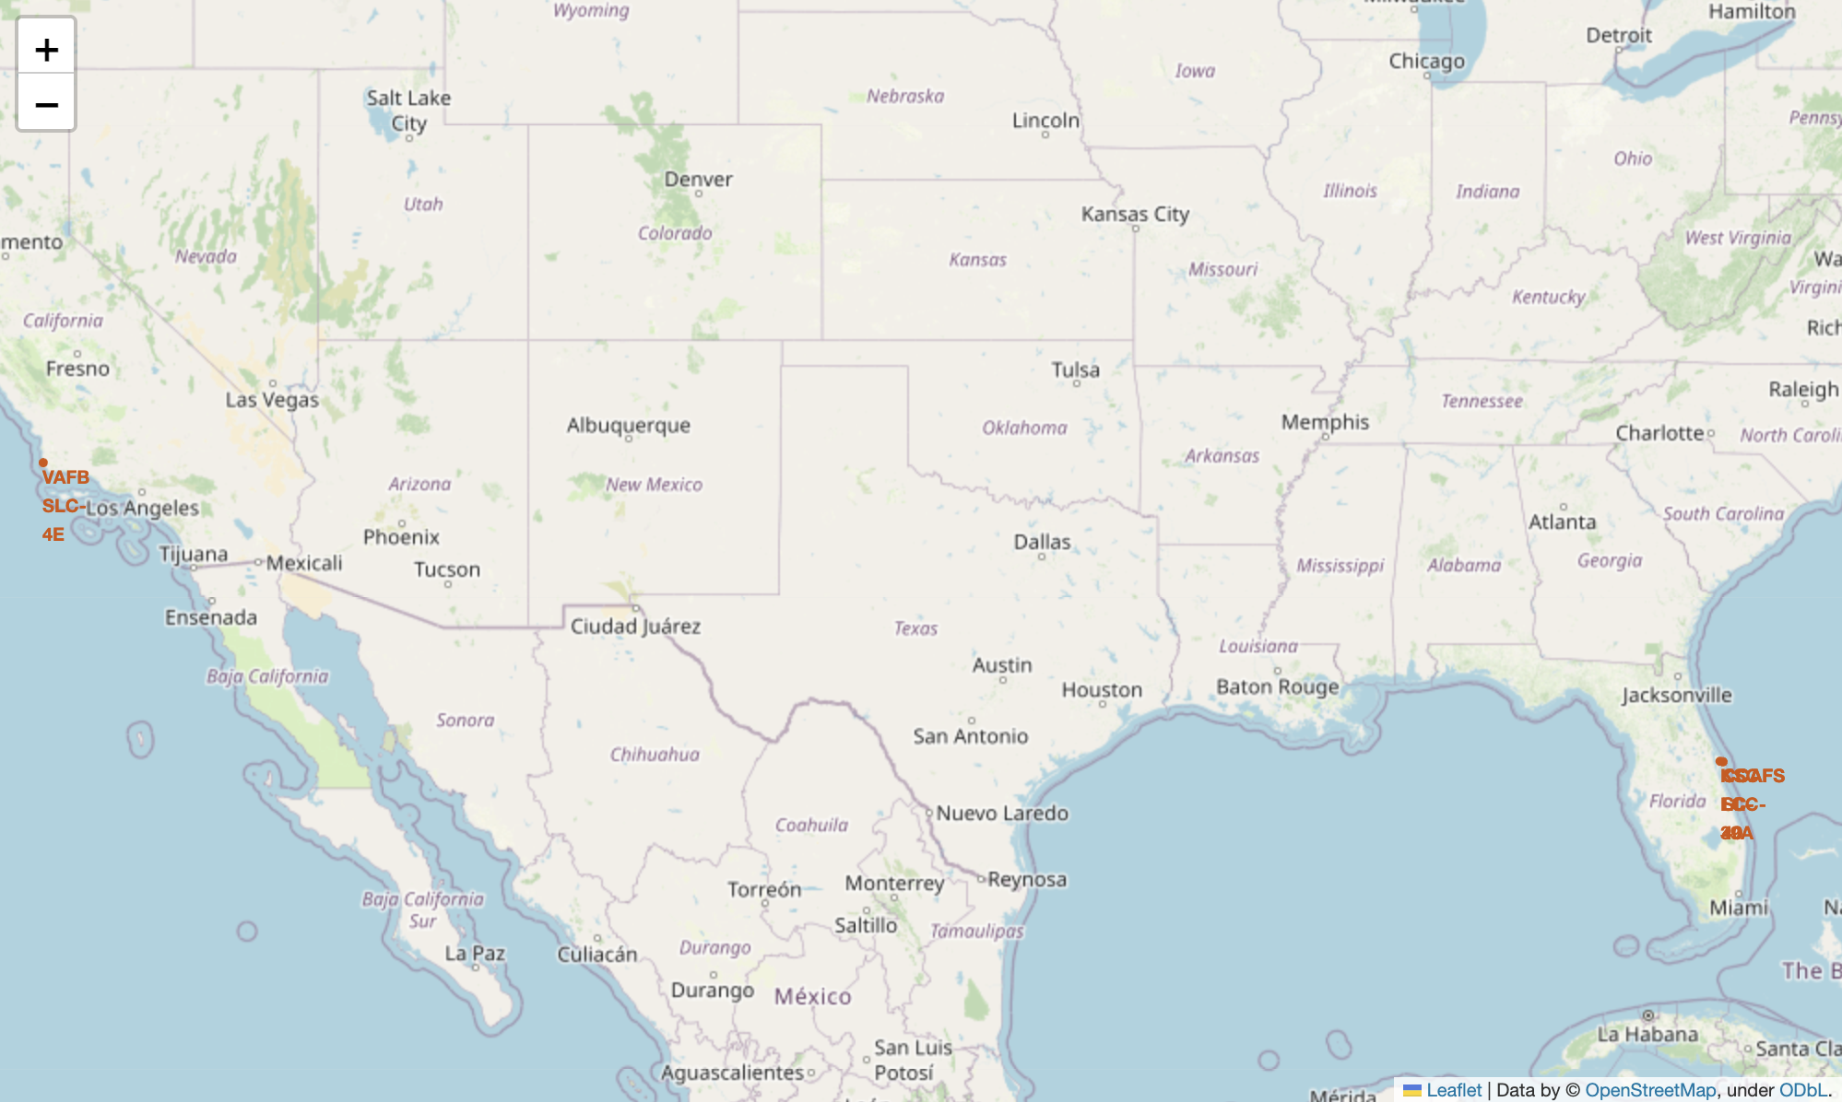
Global Launch Sites’ Location Markers
Many launch sites are situated near the Equator due to the advantage of Earth's rotational speed, reducing the need for extra fuel and enhancing cost-efficiency.
Coastal locations are predominant, enabling safe disposal of rocket stages into the ocean, reducing risks to populated areas, and facilitating transportation and assembly of rocket components.

Slide 36
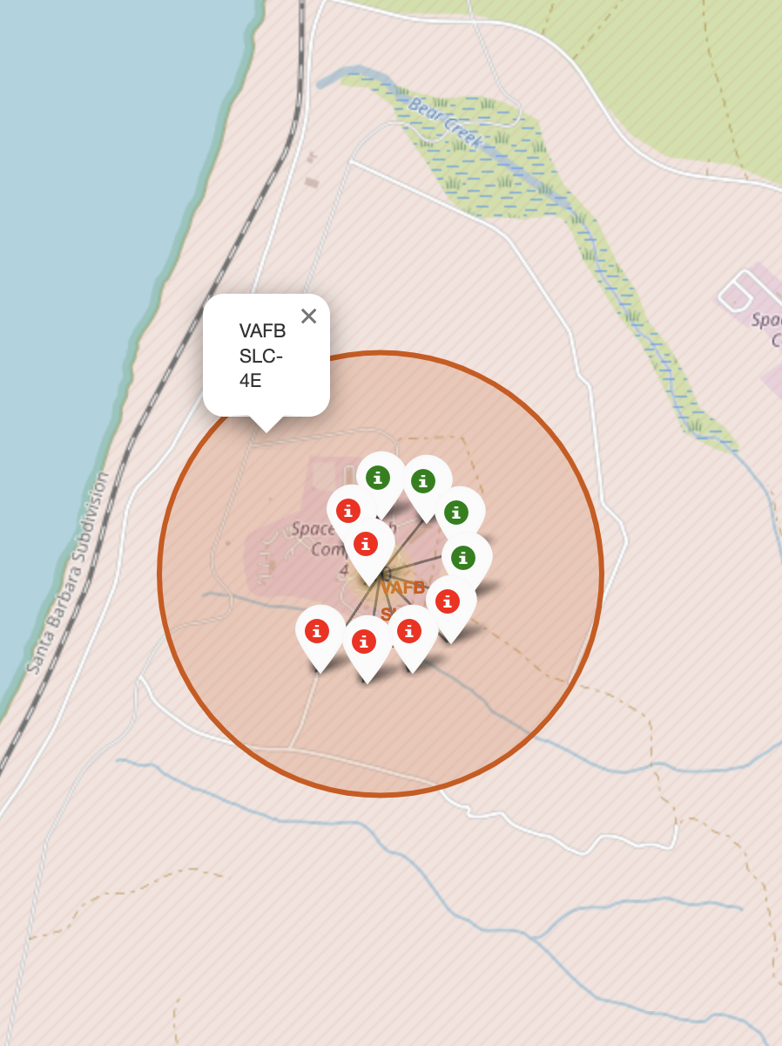
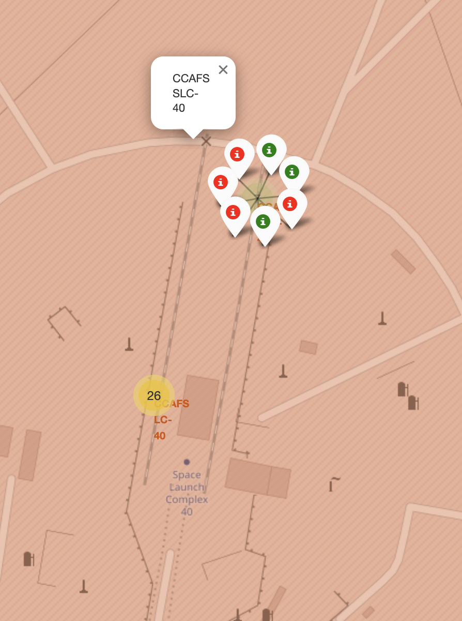
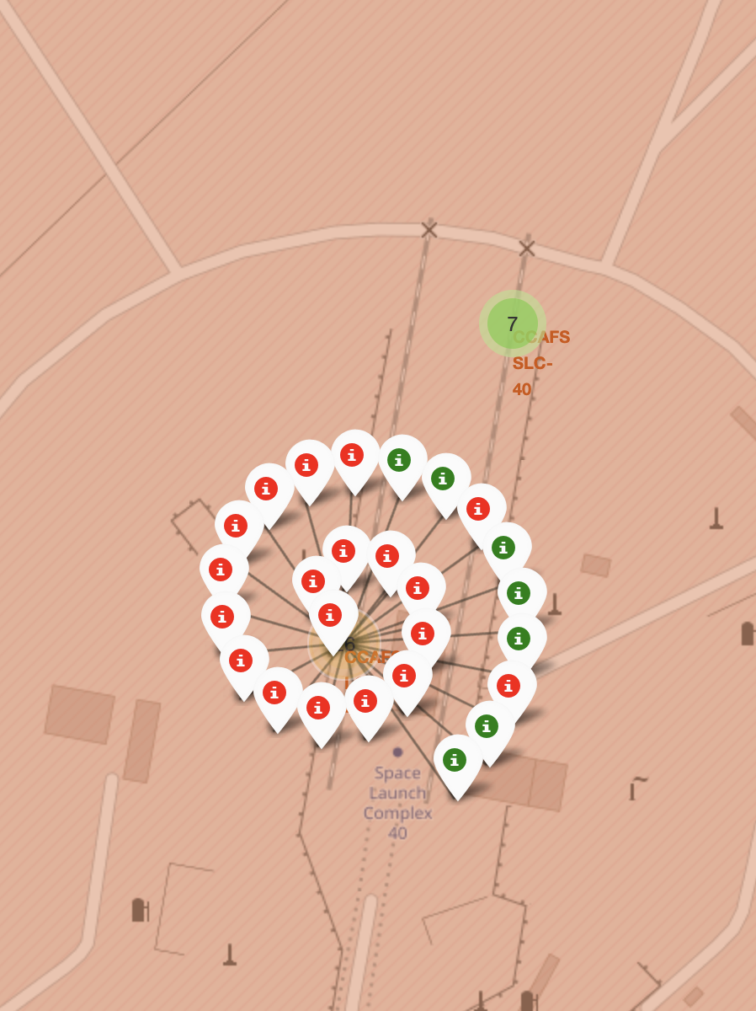
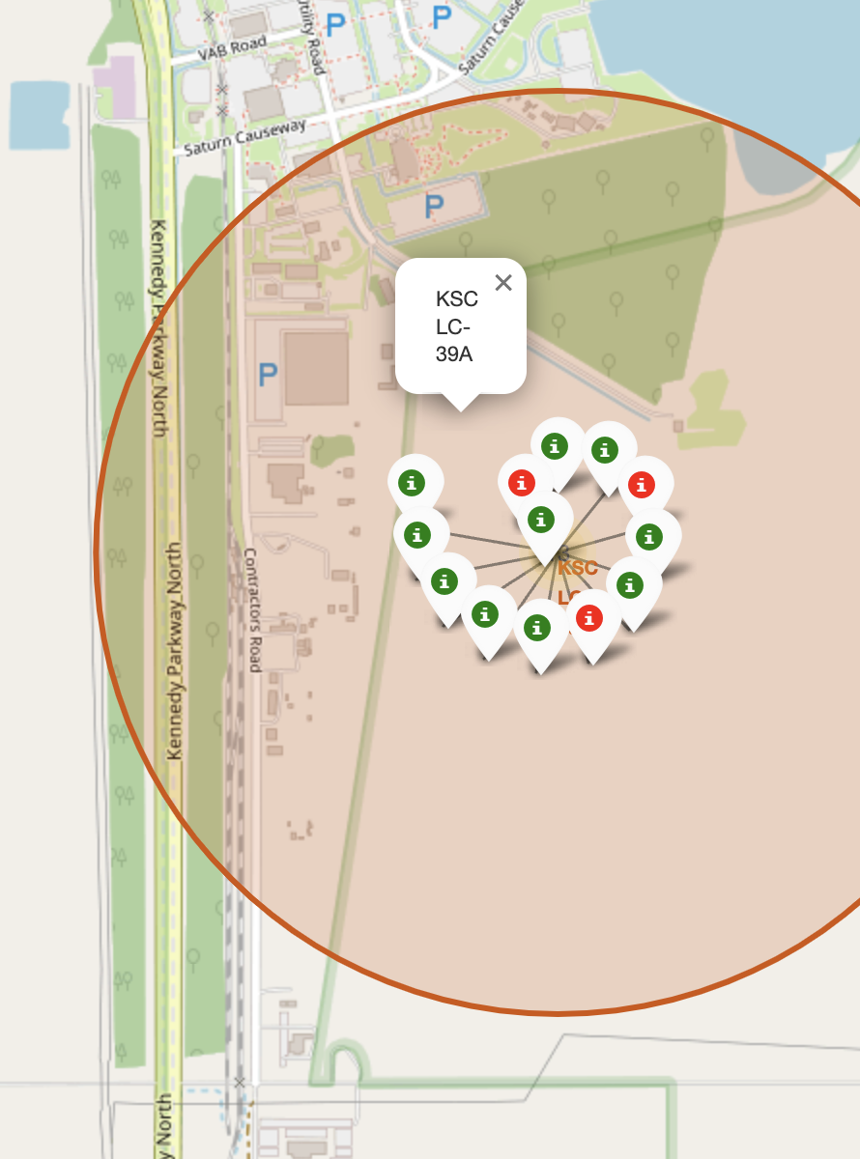
Color-labeled Launch Outcomes Map
The site that has the highest launch success rate is the KSC LC-39A, with 76.9% of success rate.

Slide 37
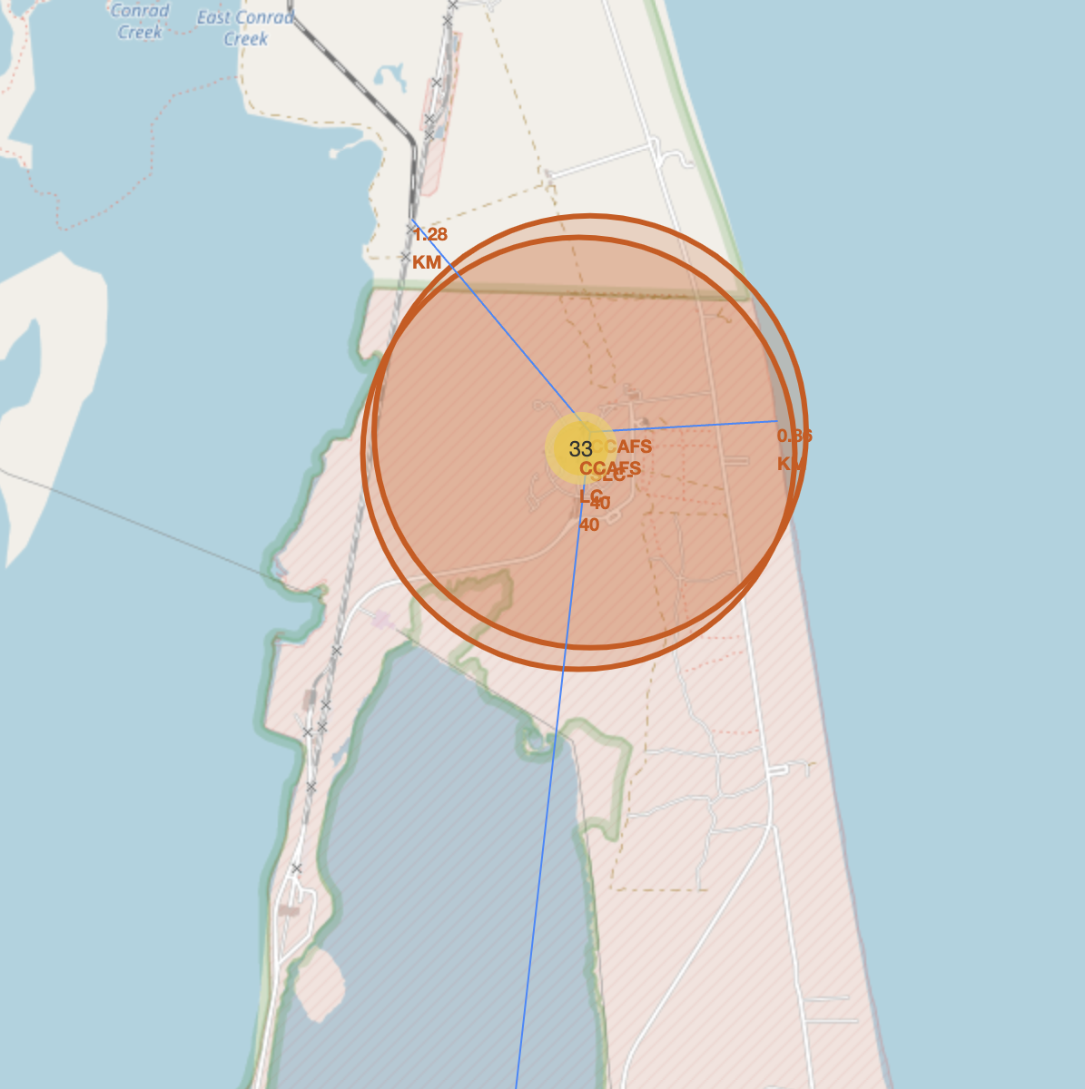
CCAFS Site Proximities
Launch sites are strategically located near coastlines for safety, avoiding overflight of populated areas, and enabling water landing in case of an abort.
Proximity to highways and railways ensures efficient transport of cargo and personnel.
Launch sites are intentionally kept at a distance from cities to reduce the risk to densely populated areas, resulting in remote locations with limited infrastructure.

Slide 38

Section 4

Slide 39
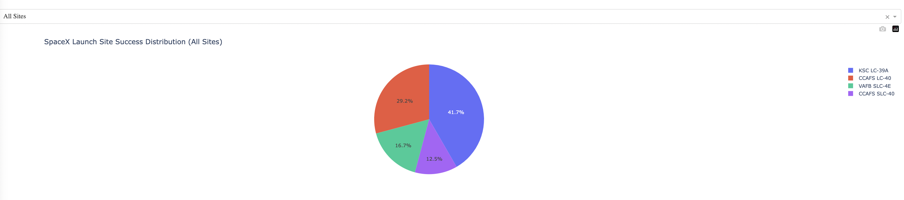
Launch Success Distribution
The site that has the largest successful launches is the KSC LC-39A, with 41.7% of total successful launches.

Slide 40
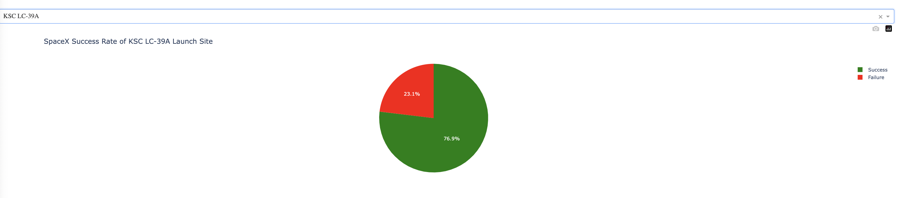
Most Successful Launch Site
The site that has the highest launch success rate is also the KSC LC-39A, with 76.9% of success rate.

Slide 41
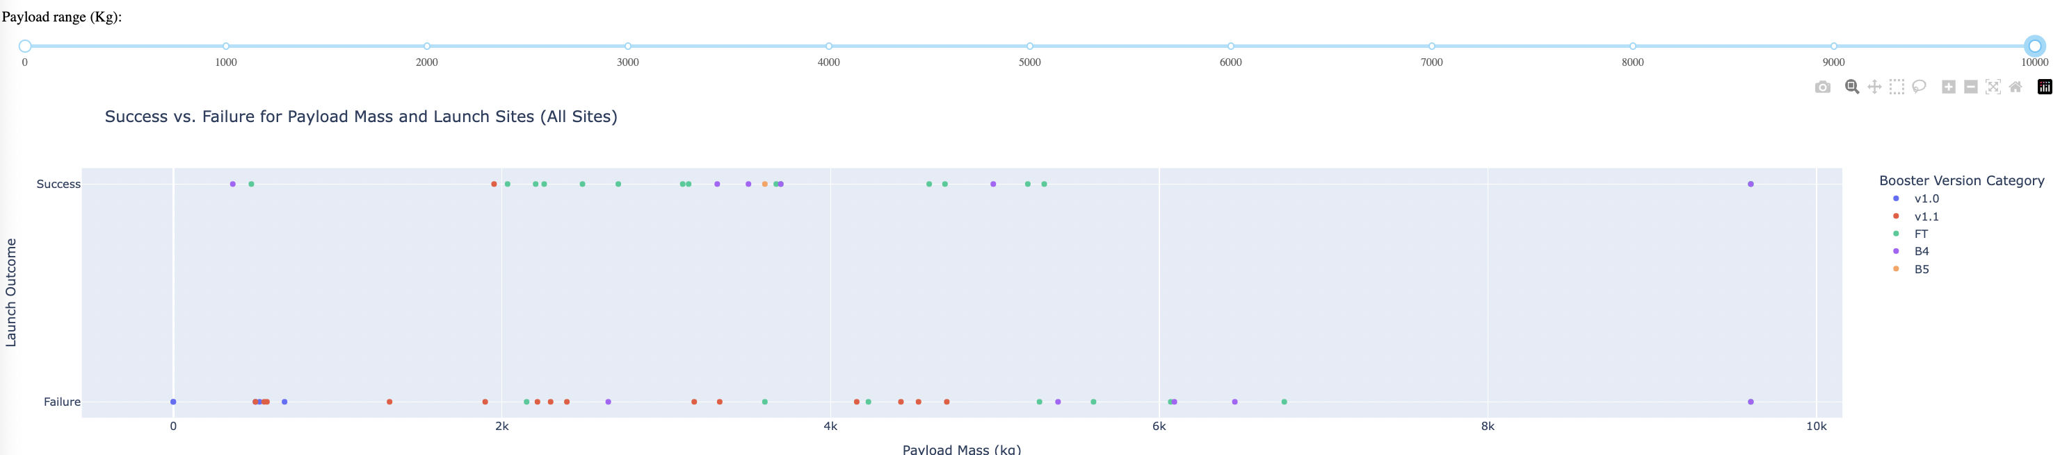
Payload vs. Launch Outcome
The highest launch success rate has a payload between 3,000 Kg and 4,000 Kg.
The lowest launch success rate has a payload between 6,000 Kg and 8,000 Kg.
The FT Booster version has the highest launch success rate.

Slide 42

Section 5

Slide 43
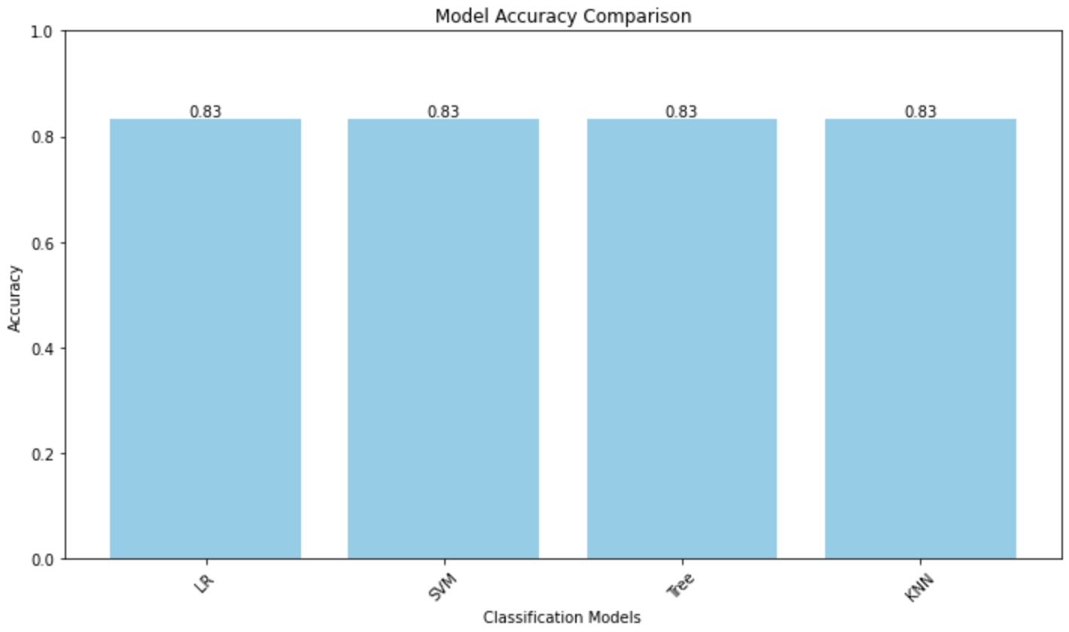
Classification Accuracy
Logistic Regression, SVM, Decision Tree, and KNN models all achieved an accuracy of 83.33% on the test data.
All models faced a challenge with false positives in their confusion matrices.
Further analysis and fine-tuning are required to mitigate false positives and enhance overall model performance.

Slide 44
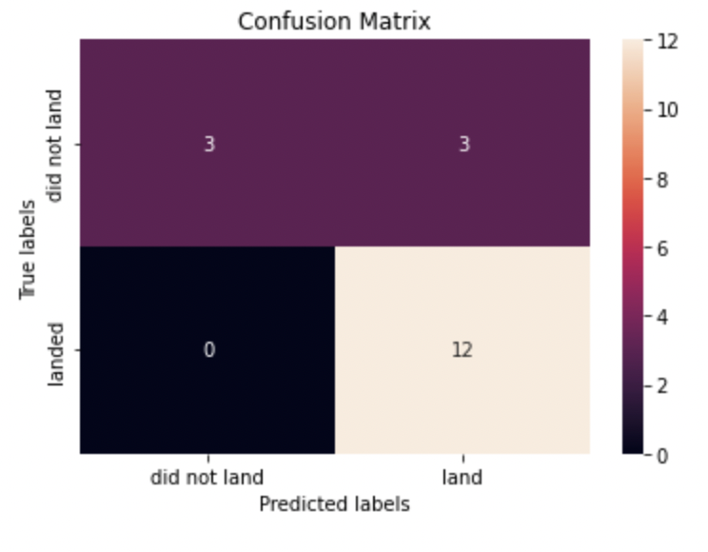
Confusion Matrix
Interpretation:
True Positives (TP): The model correctly predicted successful first stage landings 12 times.
False Positives (FP): The model incorrectly predicted successful landings 3 times when they were not.
True Negatives (TN): The model correctly predicted unsuccessful landings 3 time.
False Negatives (FN): The model incorrectly predicted unsuccessful landings 0 times when they were successful.
Summary:
The Decision Tree model has a total accuracy of 83.33% on the test data.
It excels in correctly identifying successful landings (high True Positive rate).
The major issue lies in the occurrence of false positives, where it predicts a successful landing when it's not. Further tuning is needed to reduce this issue and improve overall performance.

Slide 45
Conclusions
Project Objective:
Predict the success of SpaceX Falcon 9 first-stage landings to determine launch costs and provide insights for potential competitors in the space launch market.
Key Takeaways:
We employed four machine learning models: Logistic Regression, SVM, Decision Tree, and KNN.
All models demonstrated an identical accuracy of 83.33% on the test data.
The analysis highlighted a common issue in the form of false positives present in all models.
Implications:
Predictive models play a vital role in estimating launch costs.
Addressing the challenge of false positives is crucial for enhancing cost prediction accuracy.
Next Steps:
Further analysis and fine-tuning are essential to reduce the occurrence of false positives.
Exploring advanced modelling techniques could lead to more reliable predictions.

Slide 46
Appendix
External references
You can find the complete notebooks developed for this project in the following GitHub Repository: https://github.com/GRoncador/IBM_Data_Science_Professional_Certificate/tree/main/Certificate%20Capstone%20Project.
Acknowledgements
The project was executed on a relatively small dataset. Additional challenges and optimizations may be required to maintain model performance when scaling up to larger datasets.
It's important to acknowledge that real-world factors such as weather, external anomalies, and even geopolitical events can impact rocket landings. While not explicitly modelled, these external factors can play a significant role.

Slide 47


